Slide 1
Exclusive Corporate Briefing with Baptist Health South Florida

Slide 2
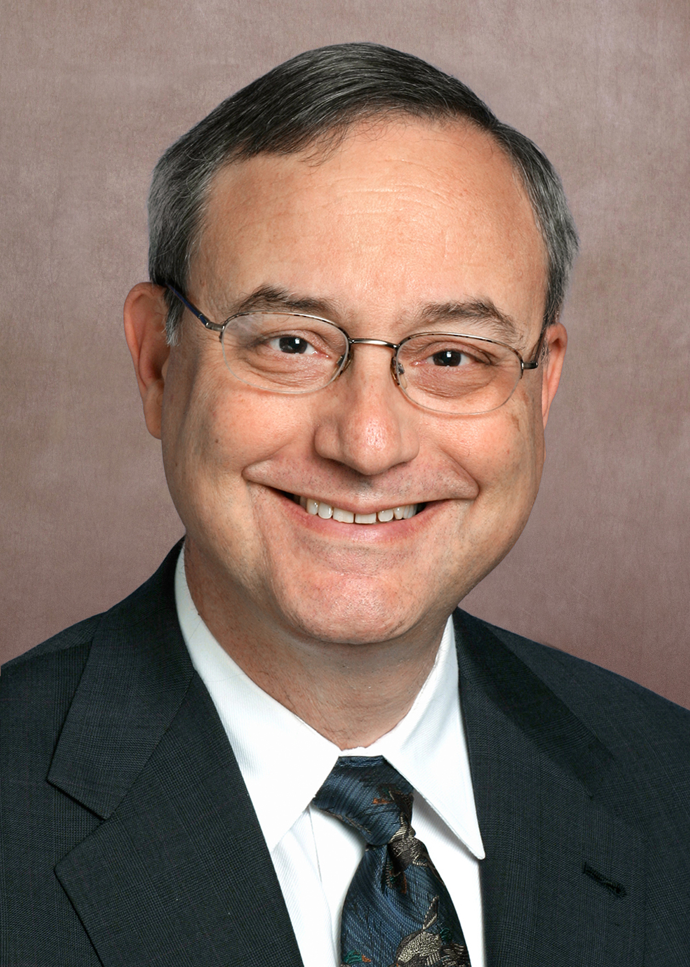
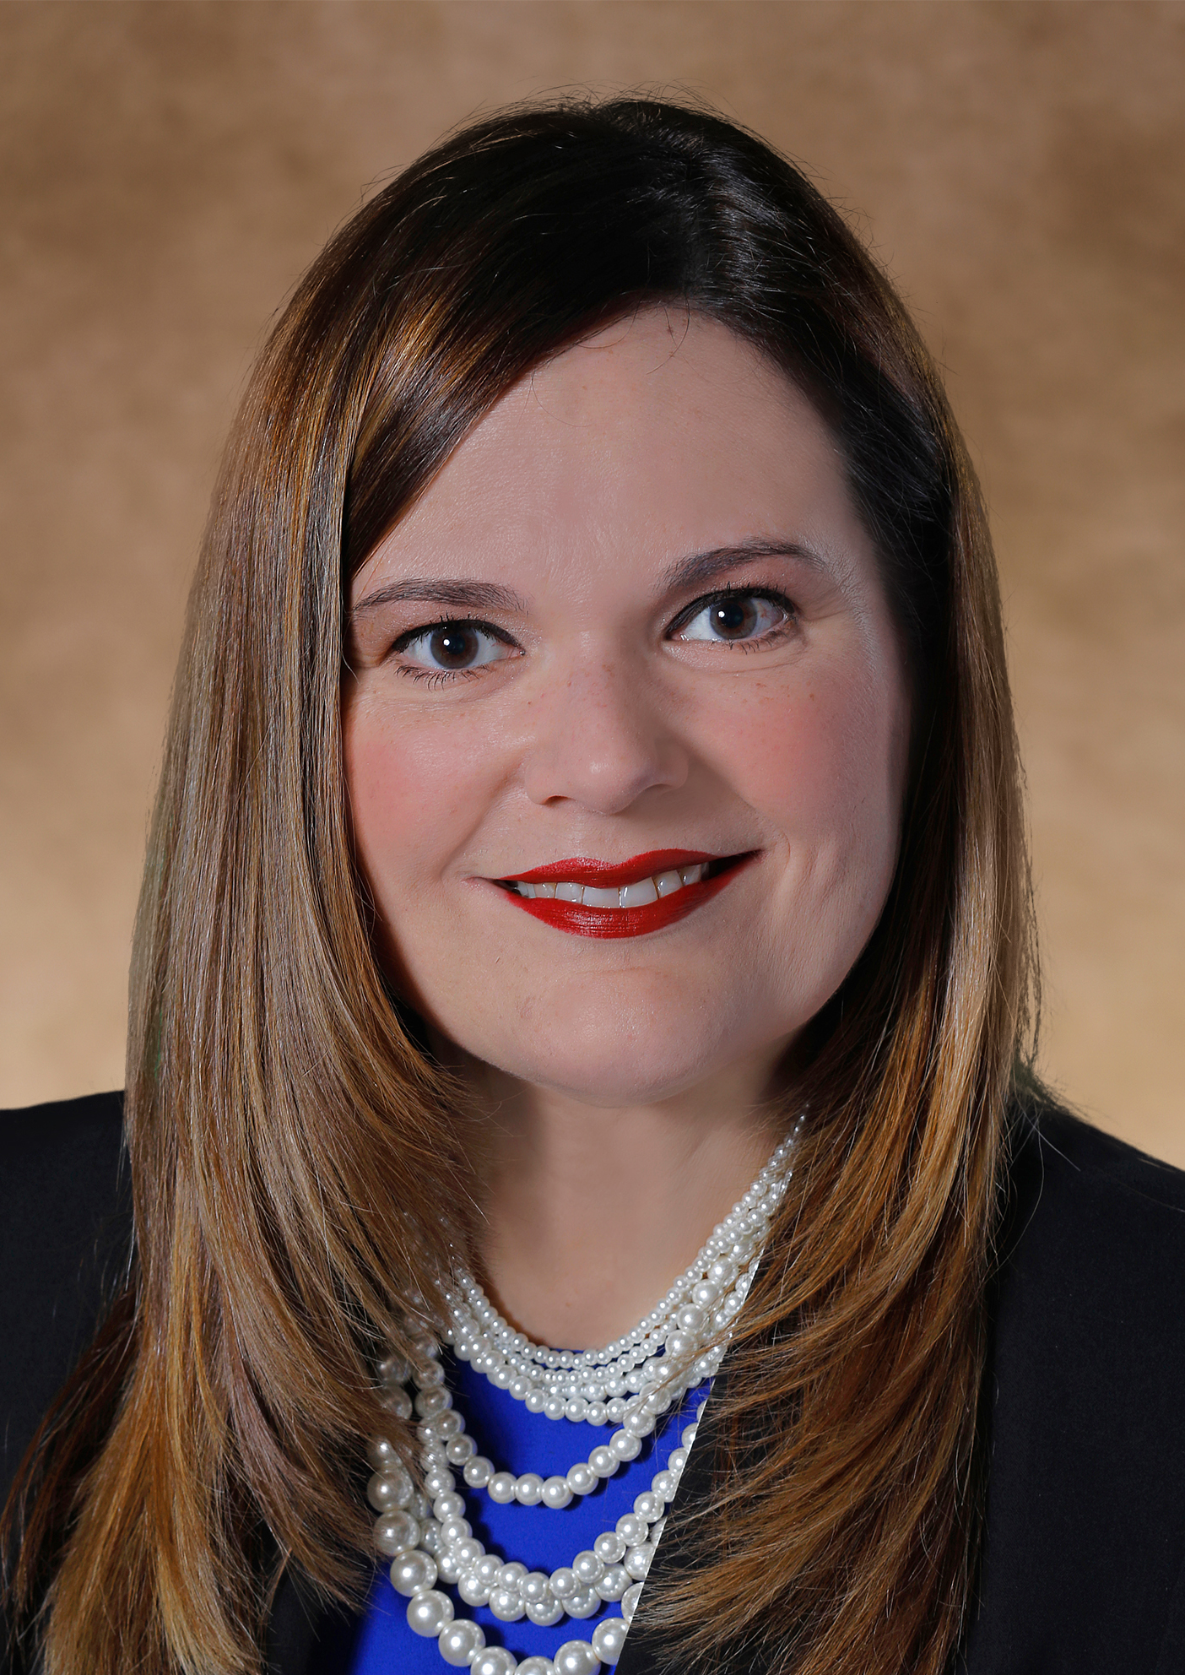
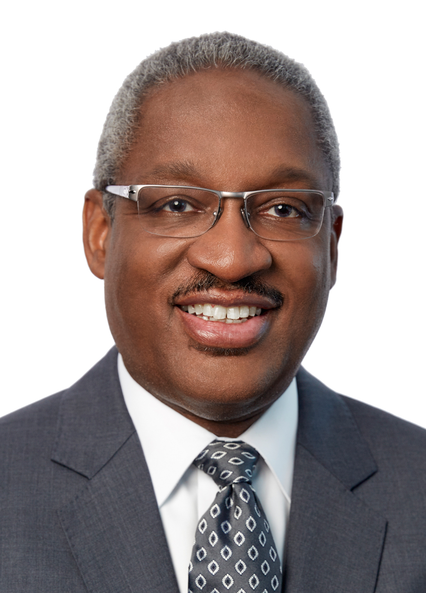
Experts
Speakers
Moderator
Mark Hauser, M.D.
President, Medical Staff Affairs and Clinical Lead for Baptist Health’s Coronavirus Response
Allan Feingold, M.D.
Medical Director, Occupational & Environmental Medicine,
South Miami Hospital
Nancy Batista-Rodriguez
CEO,
Baptist Outpatient Services and Lead for Baptist Health's Recovery Task Force
Albert E. Dotson, Jr.
Managing Partner,
Bilzin Sumberg

Slide 3
The COVID-19 Pandemic Mark J. Hauser, M.D., FACP, FCCP President, Medical Staff Affairs Clinical Enterprise May 13, 2020
The COVID-19 Pandemic

Slide 4
Introductory Comments
There are seven coronaviruses. Four cause colds, three cause worse.
Not business as usual for FDA, CDC or prestigious journals.
Cannot generalize reported experience city to city.
Florida’s social separation has served us well till now.
Established medical practice is effective.
Opening society is different from opening healthcare.
Science not politics should be supplying the answers.

Slide 5
Introductory Comments
To its detriment, the U.S. outsourced to China:
Almost all pharmacy precursor chemicals.
Almost all PPE.
Almost all electronics used in medical devices.
Allan, Nancy and I are privileged to be associated with an organization that started preparing before the first U.S. case appeared, has protected its frontline workers in face of national shortages of PPE and has developed a scientific-based playbook to bring back necessary care to our communities.

Slide 6
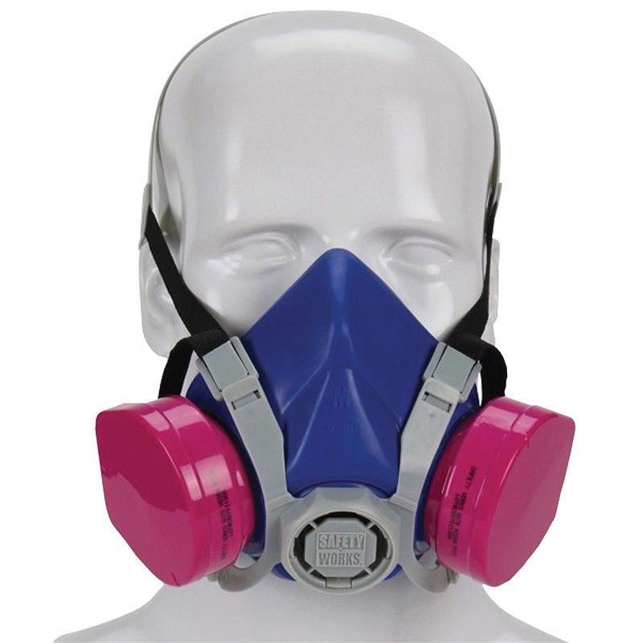
Mask Usage

