Slide 1
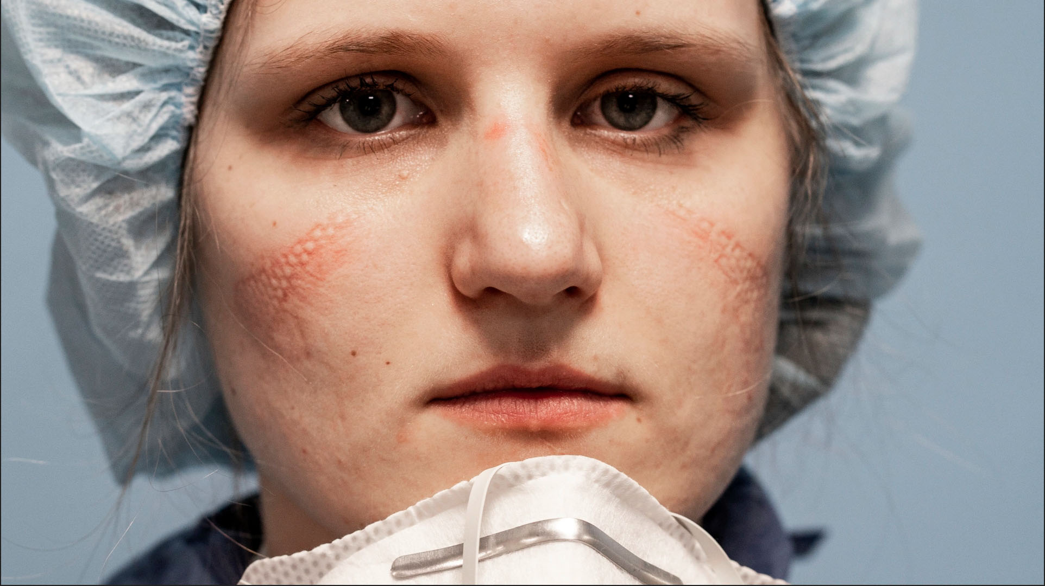
Photo by Alberto Giuliani
COVID-19 Pandemic: Lessons for All of Us
I.A. Feingold, MD, FRCP(C), FCCP
May 13, 2020

Slide 2
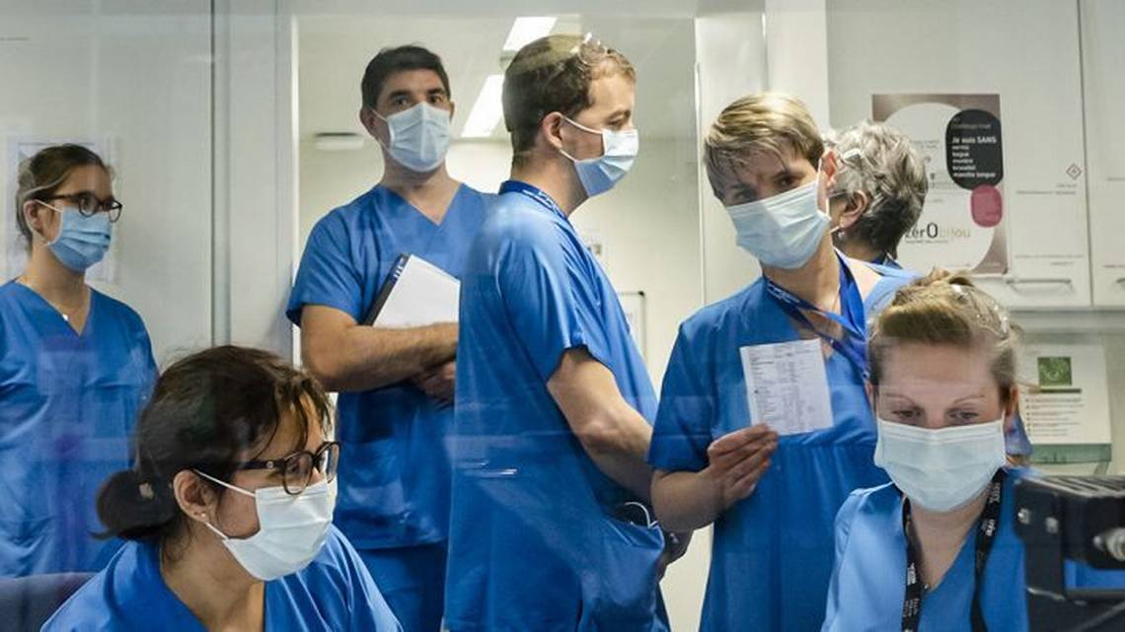
Miami Herald
The Combatants

Slide 3
San Francisco Chronicle
The Combatants

Slide 4
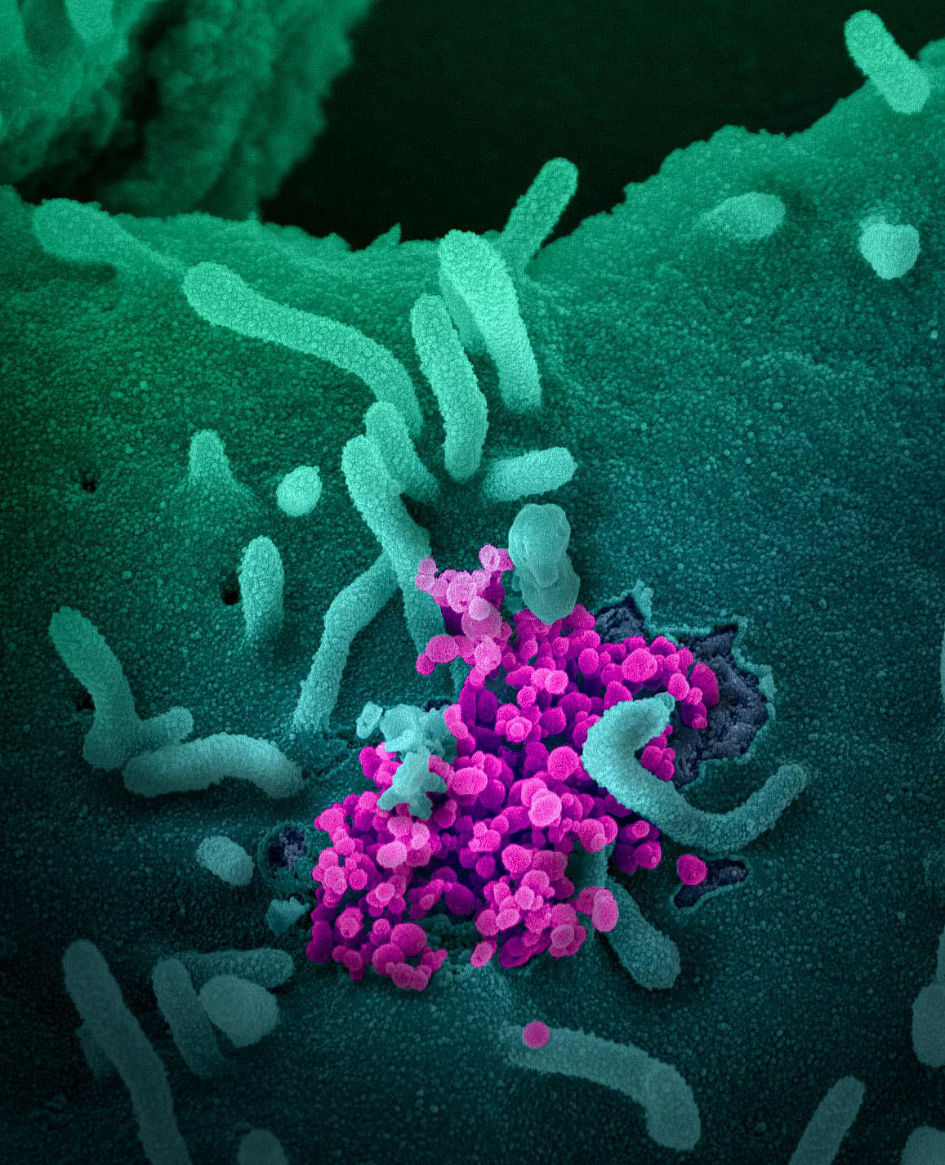
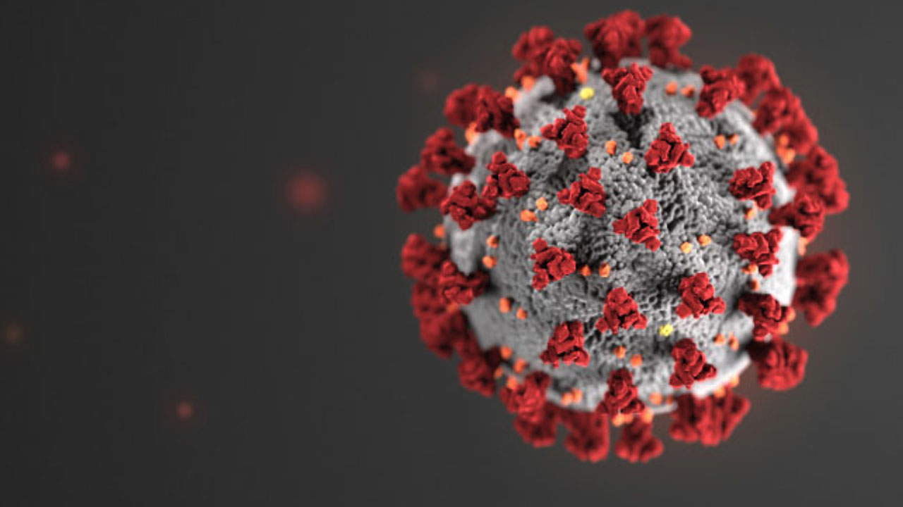
U.S. National Institutes of Health
The Enemy

Slide 5
The problem: COVID-19
Provisional: “2019 novel coronavirus (2019-nCoV)”
Severe acute respiratory syndrome coronavirus 2 (SARS-CoV-2)
COVID-19: coronavirus disease 2019
Coronaviruses are a group of related viruses that cause diseases in mammals and birds
Other coronaviruses: SARS 2002-2003 started from contact with wild animals sold as food in Guangdong, China - 8,000 people worldwide, >700 deaths, mostly > age 60, 8 cases in USA
MERS-CoV (middle east respiratory syndrome) - 2,000 cases of MERS reported by 2017 with about 600 deaths, started in Saudi Arabia

Slide 6
COVID-19 pandemic analysis
What is the cause?
Virology
What is happening?
Epidemiological analysis
Clinical medicine:
Symptoms and disease manifestations
Clinical management from mild to severe
Resource management ER, hospital beds, ICU, ventilators, expert MD’s, RN’s, resp therapists
Containment-mitigation-containment
Testing
The ultimate solution
Vaccine on the horizon

Slide 7
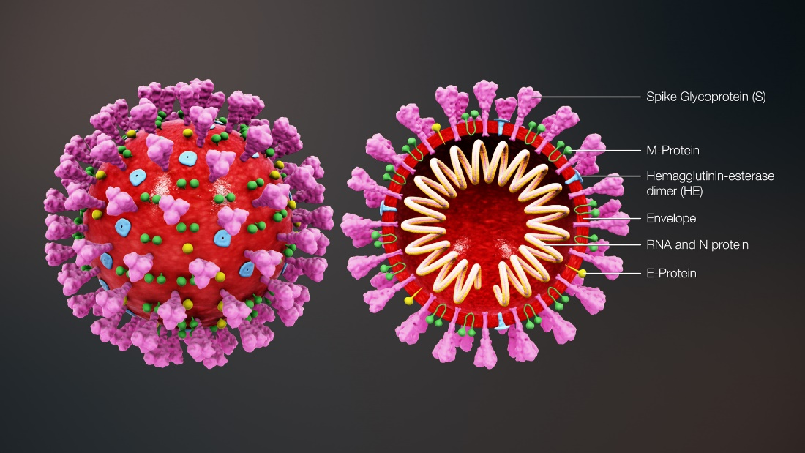
The virus
Positive-sense single-stranded RNA (+ssRNA)
Seen by electron microscopy the virus has a fringe of surface projections creating a “corona” or halo.

Slide 8
Epidemiology
The history and science of how disease affects populations.
Epidemiology informs clinical medicine and public health and serves as the basis for rational allocation of resources.

Slide 9
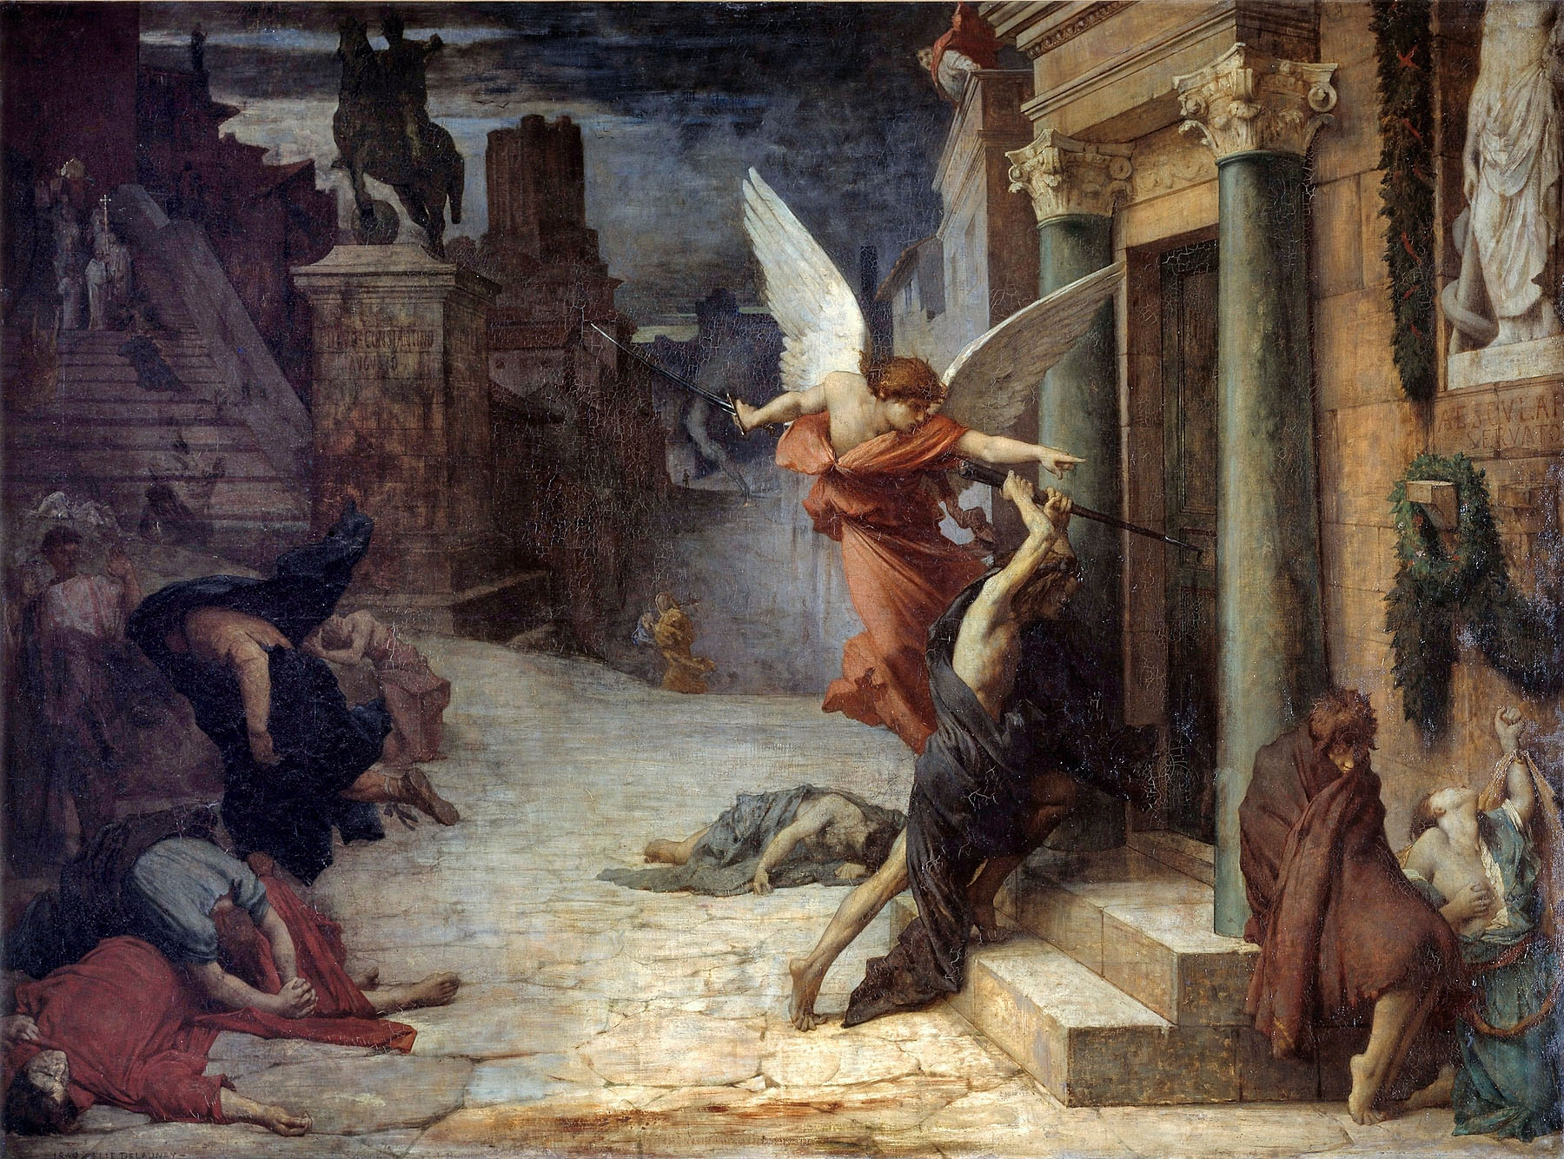
“The Plague in Rome” painted in 1869, Jules Elie Delaunay: allegorical representation of the Antonine Plague (165-180 AD) breaking down doors. 5 million deaths.

Slide 10
1918-1920 flu pandemic
First observed Ft Riley, KS
20% attack rate, 2.5-5% mortality rate world-wide
25 million deaths first 25 weeks of epidemic
Max mortality age 20-40 cytokine storm and ARDS
Estimated 50 million, possibly even 100 million deaths

Slide 11
Emergency hospital 1918, Camp Funston, KS

Slide 12
The problem: COVID-19 pandemic
Disease began in December 2019 in Wuhan, China has since spread globally
13 May 2020: 4.3 million cases in 188 countries resulting in >290,000 deaths
Life Care Center of Kirkland early epicenter for COVID-19 outbreak in the U.S.: 37 people associated with the nursing home died.
13 May 2020: 1.4 million cases USA resulting in >82,000 deaths

Slide 13
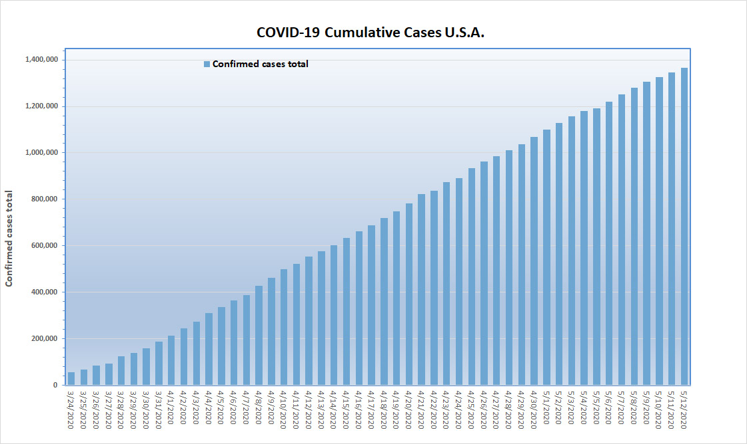

Slide 14
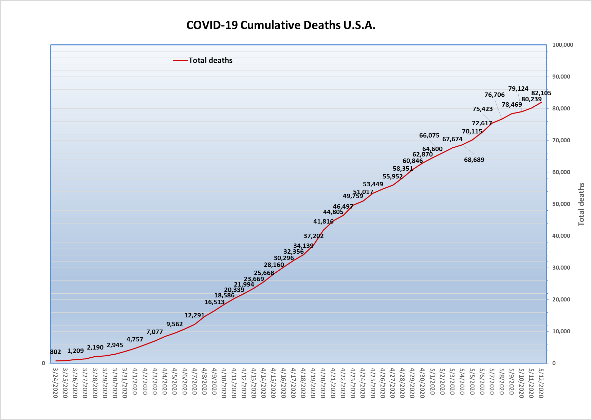

Slide 15
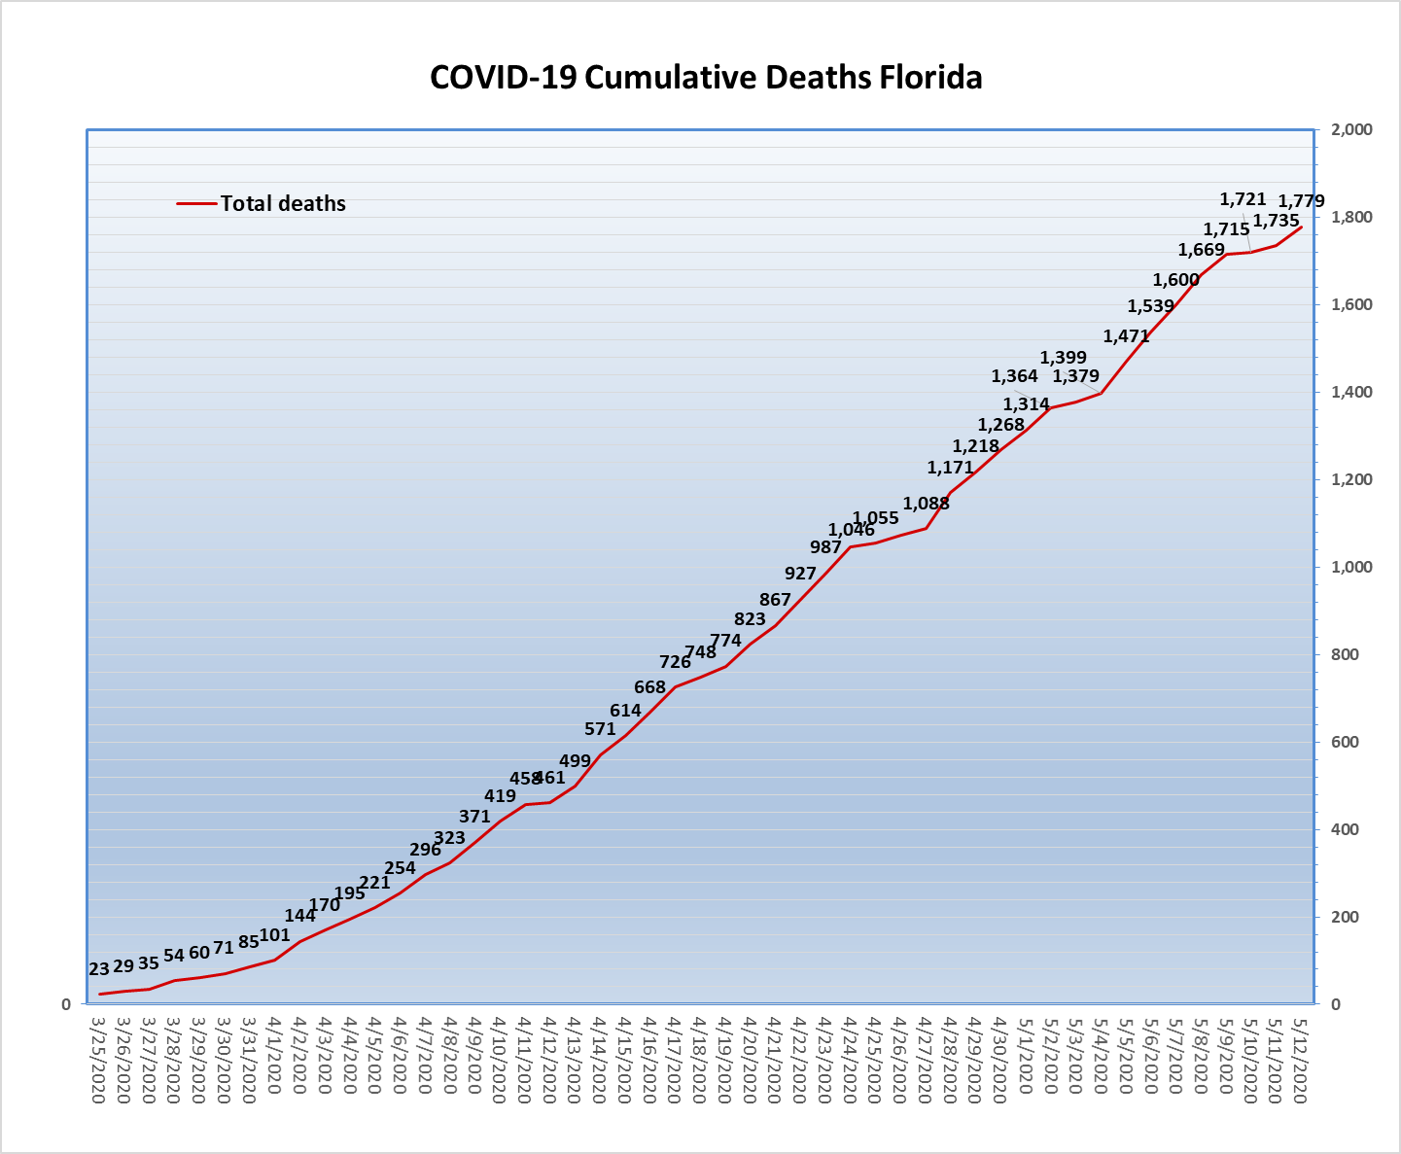

Slide 16
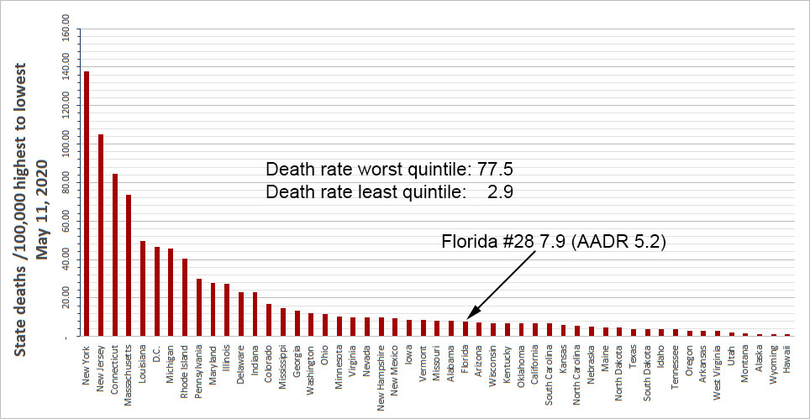

Slide 19
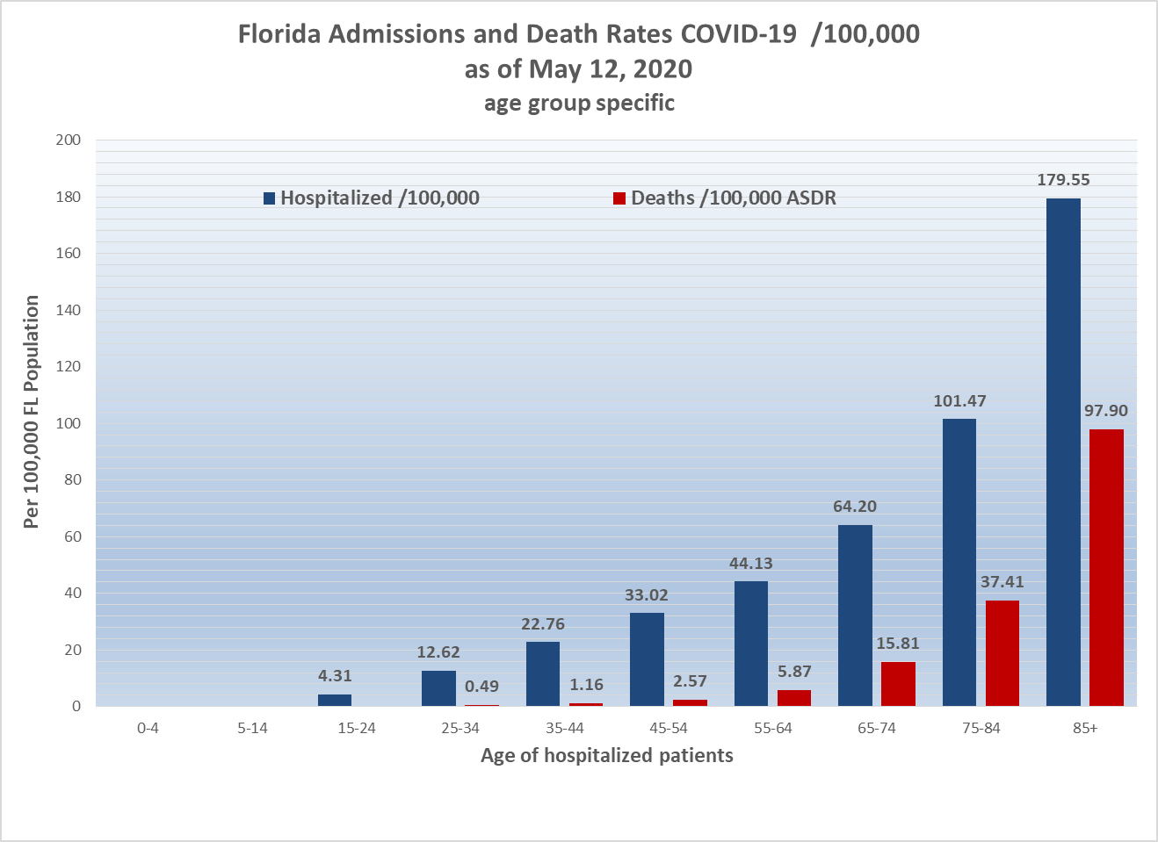

Slide 20
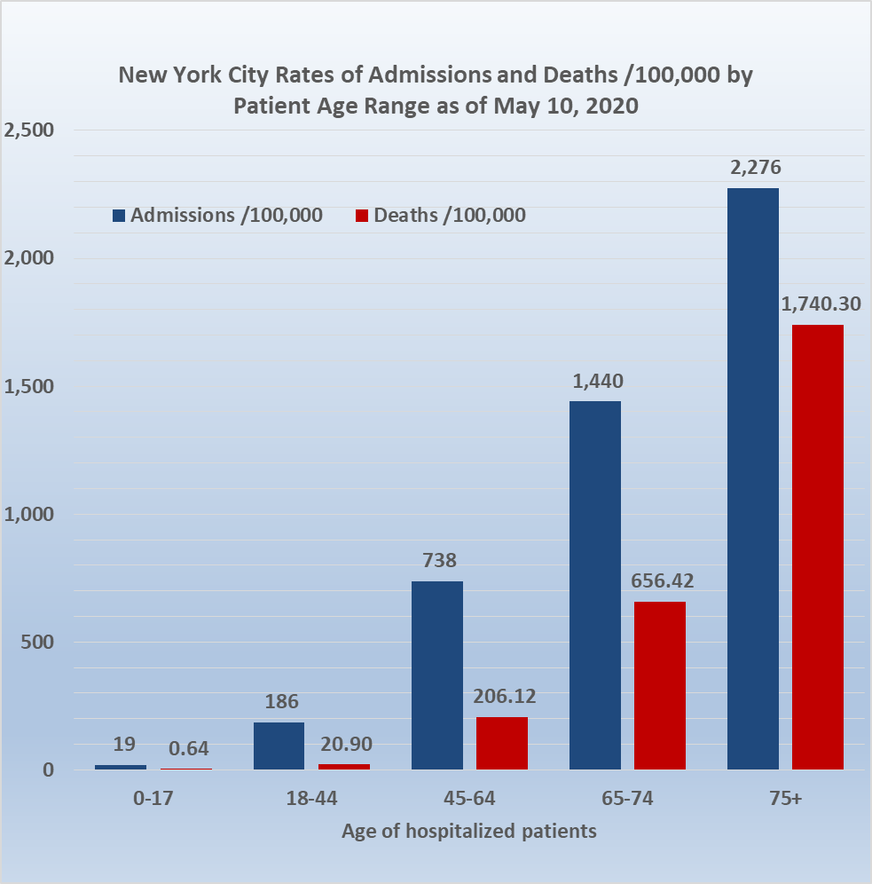

Slide 21
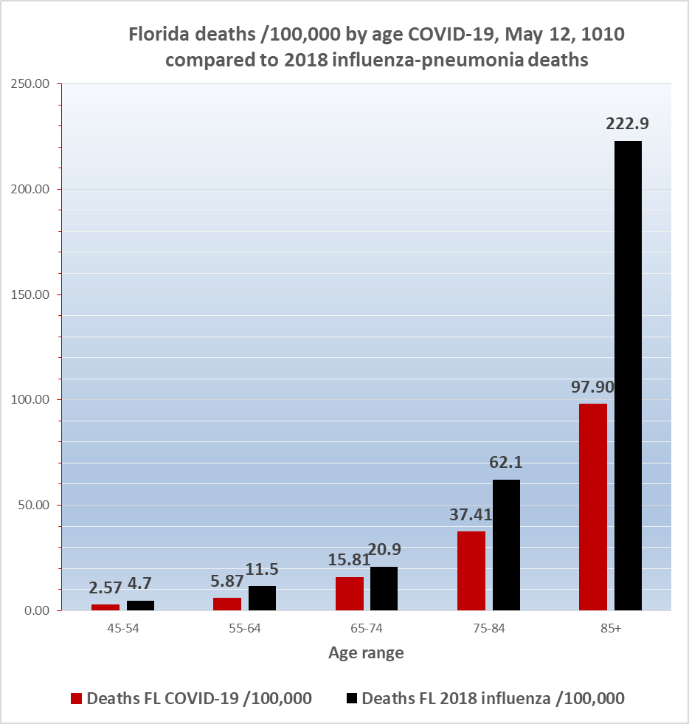
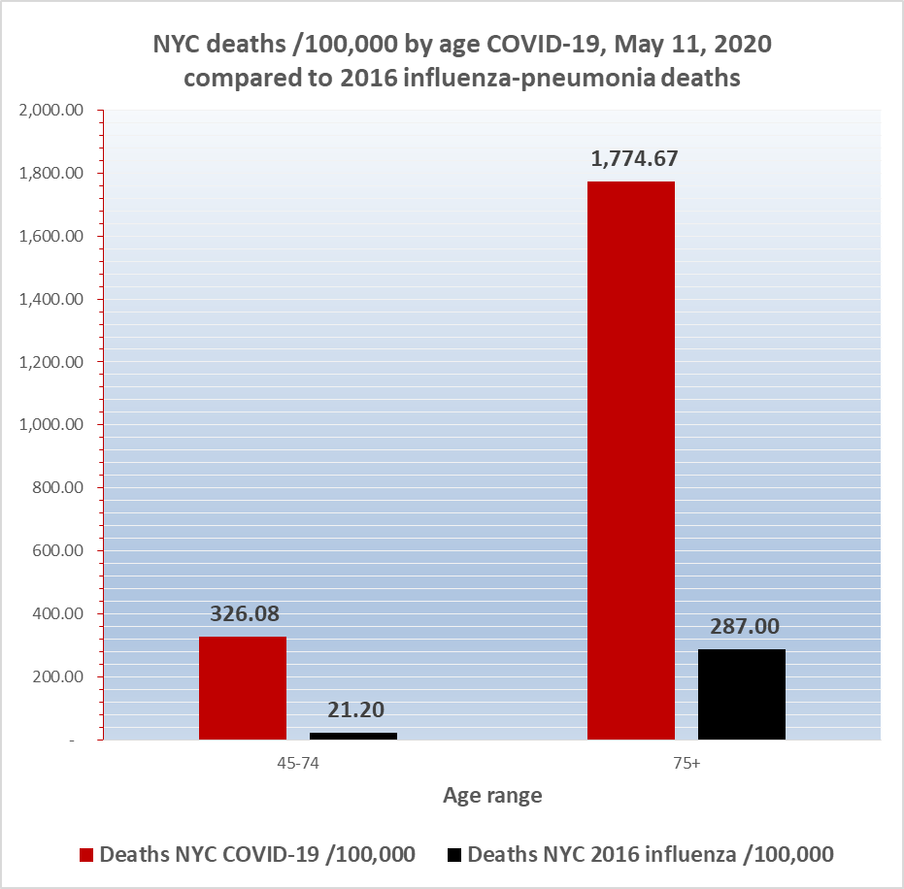

Slide 22
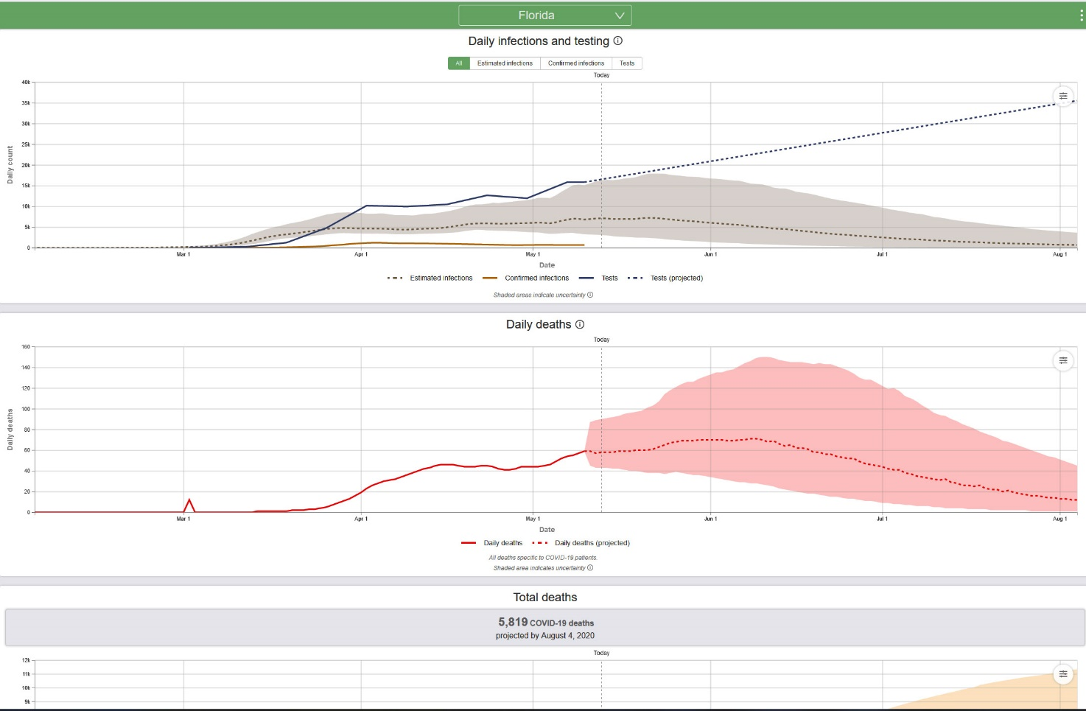
Institute for Health Metrics and Evaluation (IHME) of the University of Washington
Model run for Florida May 12, 2020
When will this be over?
Florida population 22 million. 0.3 deaths/ million = 7 deaths and 1 case per million = 22 cases
Daily deaths in Florida predicted to 12 by August 4, 2020. Incidence will probably decline to 22 cases some time in late summer or early fall. Based on what we know today and based on the current IHME model, that is when the epidemic will be over in Florida.

Slide 23
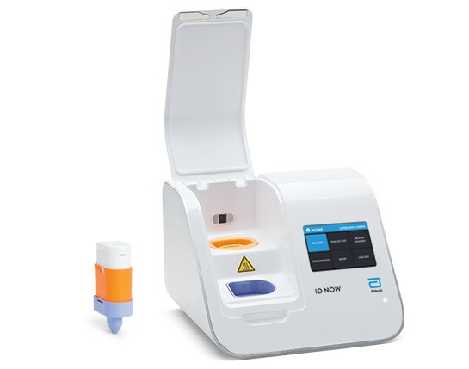
COVID-19 available tests
Nasal, throat, nasopharyngeal swabs for detection of RdRp (RNA-directed RNA polymerase) gene
Despite its name, isothermal nucleic amplification is much simpler and faster than real-time reverse transcription polymerase chain reaction (RT-PCR) for detection of COVID-19 RdRP
Abbott NOW for “near patient” testing

Slide 24
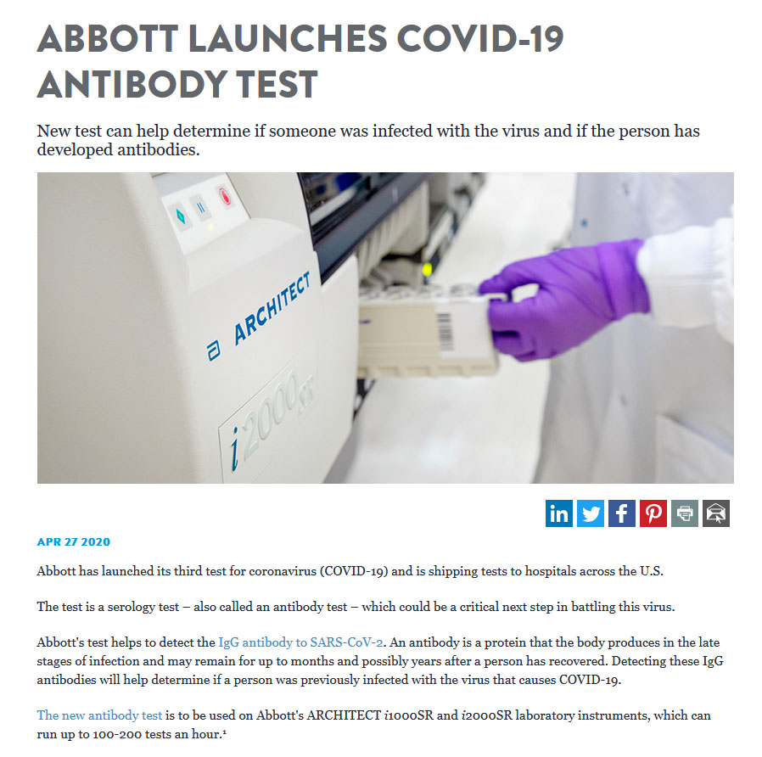

Slide 25
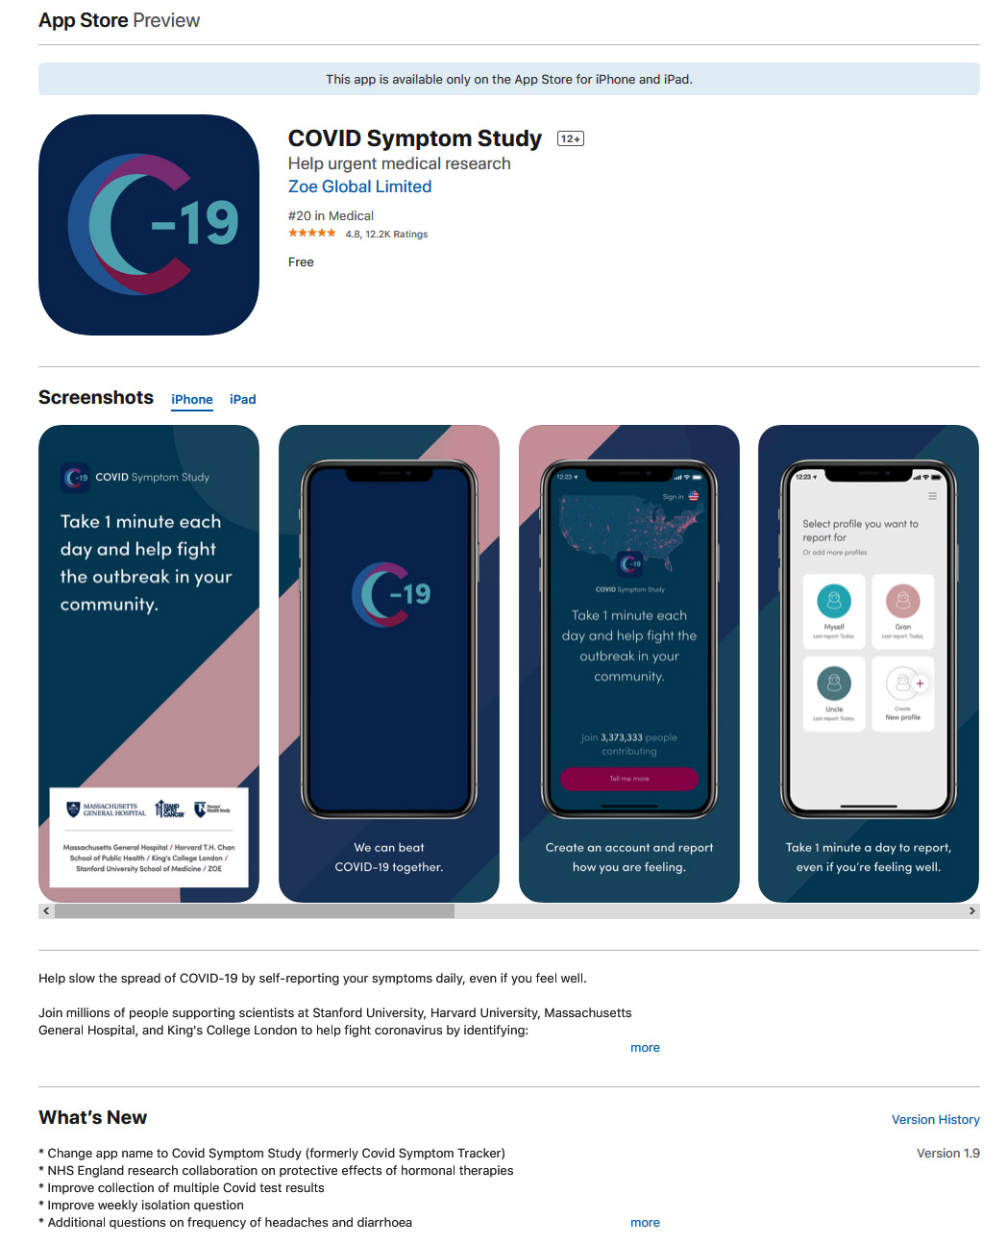

Slide 26
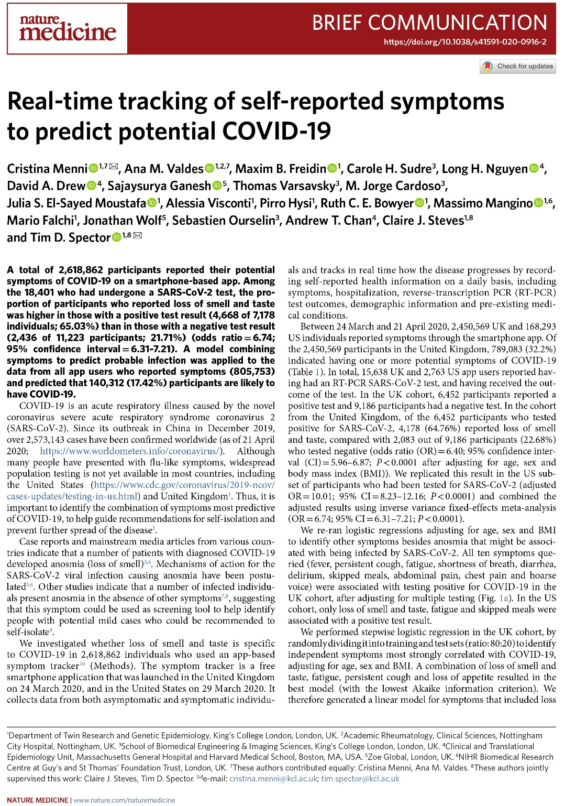

Slide 27
Goals of testing
Differential diagnosis:
Even during COVID-19 epidemic patients may develop other respiratory infections including influenza and pneumonia
However, certain clinical manifestations are now understood to be strongly suggestive of COVID-19 and testing is really not necessary
Protection of doctors and nurses
Patients presenting to ER
Pre-op patients
Protection of patients, especially vulnerable (chemo)
Nasal swab +/- IgG to “clear” staff to return to work
Containment: contact tracing
Nasal swab of contacts in order to achieve early quarantine

Slide 28
Goals of testing
Management:
There is still no effective non-toxic treatment; therefore, positive test does not help select Rx
Young generally healthy patients who have mild to moderate disease should stay at home whether their test is positive or negative. Telemedicine and pulse oximetry valuable.
Nasal swab nucleic testing should be performed on patients 55+ and those with risk factors for severe outcome (immunocompromise, diabetes, obesity) because positive result will influence admission decision.

Slide 29
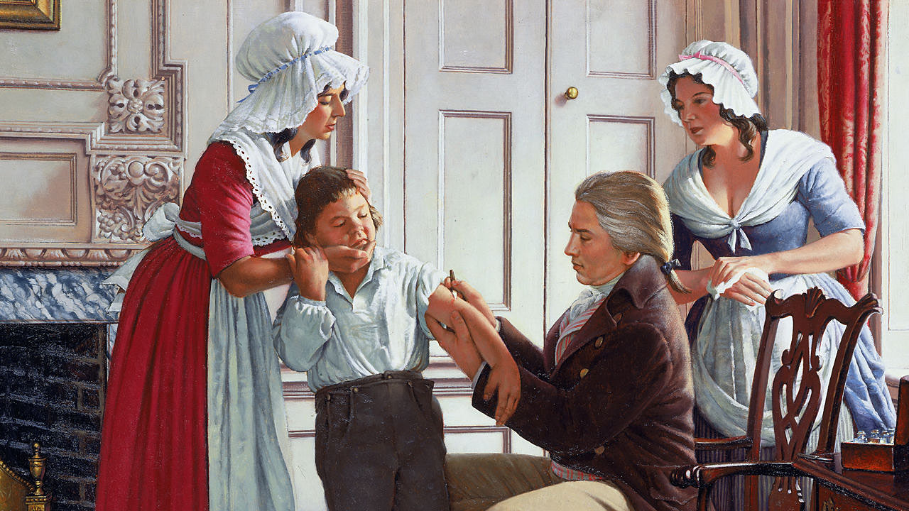
“Jenner: Smallpox is Stemmed” by Robert A. Thom (1915-1979). This painting depicts the use of the first Western vaccine:
the cowpox vaccine to protect against smallpox. Edward Jenner, a rural English doctor, is shown injecting his first patient,
James Phipps, in 1796, using fluid obtained from scratches on the hand of dairymaid Sarah Nelmes, standing behind him.

Slide 30
COVID-19: Lessons for all of us
75% of all newly identified infectious diseases are zoonotic.
The world is small. Additional pandemics will occur and we should have systems in place.
Life expectancy is increasing. Less than 1% of Americans die each year. But life is fragile.
Viruses are about 0.1 μm (millionth of a meter) in size (a red blood cell is 8 μm), about 100 times smaller than bacteria, but they can kill us.
Some infections kill children, some kill old people. Every life is precious.
Medicine and nursing are noblest of the professions.

